Slide 1

Object-Oriented Programming
Design Pattern

Slide 2
Objectives
Describe polymorphism
Describe the procedure to override methods of the Object class
Explain design patterns
Describe the Singleton, Data Access Object (DAO), and Factory and Observer design patterns
Describe delegation
Explain composition and aggregation

Slide 3
Introduction
The concept of polymorphism can be applied to Java.
In Java, a subclass can have its own unique behavior even while sharing certain common functionalities with the parent class.

Slide 4
Implementing Polymorphism [1/3]
A super class named Car has been created having two methods, accelerate() and printDescription().
A sub class named LuxuryCar is created based on Car and overrides the methods of the Car class.
Code Snippet
class LuxuryCar extends Car {
// LuxuryCar defines an additional feature named perks
public String perks;
public LuxuryCar(int mileage, String color, String make, String perks)
{
super(mileage, color, make);
this.perks = perks;
}

Slide 5
Implementing Polymorphism [2/3]
public void accelerate() {
System.out.println(“Luxury Car is Accelerating”);
}
public void printDescription() {
super.printDescription();
System.out.println(“The “ + “Luxury car is a: “ + this.perks +
“.”);
}
}

Slide 6
Implementing Polymorphism [3/3]
Code Snippet 2 creates two instances of type Car, instantiates them, and invokes the accelerate() and printDescription() methods on each instance respectively.
Code Snippet
public class PolymorphismTest {
public static void main(String[] args) {
Car objCar, objLuxuryCar;
objCar = new Car(80, “Red”, “BMW”);
objLuxuryCar = new LuxuryCar(120, “Yellow”, “Ferrari”, “Sports Car”);
objCar.accelerate();
objCar.printDescription();
//System.out.println(“Now inside LuxuryCar”);
objLuxuryCar.accelerate();
objLuxuryCar.printDescription();
}
}

Slide 7
Overriding the Methods of Object Class [1/12]
Object is the root class.
Its methods can be overridden by any class (unless the methods are marked as final).
Following are the methods that can be overridden with a different functionality as compared to the root class:
public boolean equals(Object obj)
public int hashCode()
public String toString()
The equals() method compares two objects to determine if they are equal.
There are two different types of equality. They are:
Reference equality
Logical equality
Reference equality is when the physical memory locations of the two strings are same.
Logical equality is when data in the objects are the same.

Slide 8
Overriding the Methods of Object Class [2/12]
Code Snippet
public class EqualityTest {
public static void main(String[] args) {
String strAObj = new String(“JOHN”);
String strBObj = new String(“JOHN”);
String strCObj = new String(“ANNA”);
String strEObj = strAObj;
System.out.println(strAObj == strBObj);
System.out.println(strAObj == strCObj);
System.out.println(strAObj == strEObj);
}
}

Slide 9
Overriding the Methods of Object Class [3/12]
The equality operator (==) compares the memory addresses of the two strings.
When strAObj is compared to strBObj, the result is false, although their value is same, which is JOHN.
A comparison between strAObj and strCObj returns false because the references of the two different String objects are different addresses.
When strAObj is compared to strEObj, the result is true because they point to the same memory location.
The Code Snippet displays the following output:

Slide 10
Overriding the Methods of Object Class [4/12]
Code Snippet
public class LogicalEqualityTest {
public static void main(String[] args) {
// TODO code application logic here
String strAObj = new String(“JOHN”);
String strBObj = new String(“JOHN”);
String strCObj = new String(“ANNA”);
// Create a String reference and assign an existing
// String’s reference
// to it so that both references point to the same
// String object in memory.
String strEObj = strAObj;

Slide 11
Overriding the Methods of Object Class [5/12]
// Print the results of the equality checks
System.out.println(“=============================”);
System.out.println(“Logical or Value Equality”);
System.out.println(“=============================”);
//Tests logical or value equality
System.out.println(strAObj.equals(strBObj));
System.out.println(strAObj.equals(strCObj));
System.out.println(strAObj.equals(strEObj));
}
}

Slide 12
Overriding the Methods of Object Class [6/12]
The equals() method is used to check for logical equality.
Note that the equals() method is implicitly inherited from the Object class.
The String class overrides the equals() method and compares the two String objects character by character.
The Code Snippet displays the following output:

Slide 13
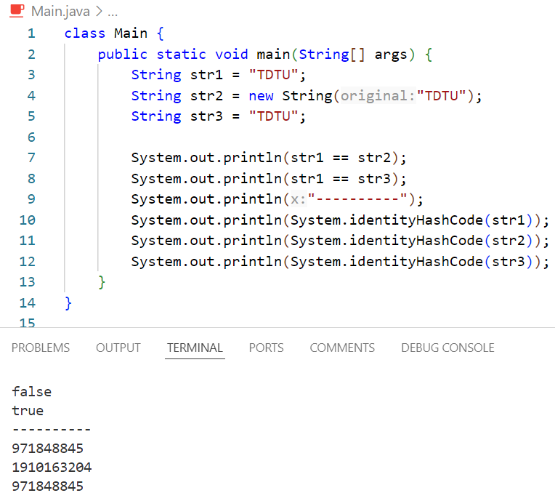

Slide 14
Overriding the Methods of Object Class [7/12]
The hashCode() method of Object class returns the object’s memory address in hexadecimal format.
It is used along with the equals() method in hash-based collections such as Hashtable.
If two objects are equal, their hash code should also be equal.
Code Snippet
public class Student
{
private int ID;
public int getID() {
Scanner sc = new Scanner(System.in);
System.out.println(“Enter values”);
int ID = Integer.parseInt(sc.nextLine());
return ID;
}

Slide 15
Overriding the Methods of Object Class [8/12]
public boolean equals(Object obj) {
if (getID() == ((Student) obj).getID())
return true;
else
return false;
}
public int hashCode() {
return ID;
}

Slide 16
Overriding the Methods of Object Class [9/12]
public static void main(String[] args)
{
Student s1 = new Student();
Student s2 = new Student();
if (s1.equals(s2))
System.out.println(“The two ID values are equal”);
else
System.out.println(“The two ID values are not equal”);
}
}

Slide 17
Overriding the Methods of Object Class [10/12]
The Student class defines three methods in addition to main() method.
The getID() method accepts an ID value from the standard input.
The overridden equals() method accepts a parameter of type Object.
It compares the ID value of this object with the ID value of the current object.
The overridden hashCode() method returns the ID value.
In the main() method, two objects of Student class, namely, s1 and s2 are created.
The equals() method is invoked on s1 and the object s2 is passed as a parameter.
Depending on the user input, the output will be displayed accordingly.

Slide 18
Overriding the Methods of Object Class [11/12]
The toString() method of Object class returns a string representation of the object.
It is typically used for debugging.
Code Snippet
public class Exponent {
private double num, exp;
public Exponent(double num, double exp) {
this.num = num;
this.exp = exp;
}

Slide 19
Overriding the Methods of Object Class [12/12]
/* Returns the string representation of this number.
The format of string is “Number + e Value” where Number is the number value and e Value is the exponent part. */
@Override
public String toString() {
return String.format(num + “E+” + exp);
}
public static void main(String[] args) {
Exponent c1 = new Exponent(10, 15);
System.out.println(c1);
}
}

Slide 20
The instanceof Operator [1/4]
The instanceof operator is used to compare an object to a specified type such as instance of a class and an instance of a subclass.
Code Snippet
class Employee {
int empcode;
String name;
String dept;
int bonus;
}
class Manager extends Employee {
String name;
int mgrid;
}

Slide 21
The instanceof Operator [2/4]
public class Square {
public static void main(String[] args) {
Employee emp1 = new Employee();
Scanner sc = new Scanner(System.in);
System.out.println(“Enter values”);
emp1.name = sc.nextLine();
Employee m1 = new Manager();
m1.name = sc.nextLine();
if (emp1 instanceof Employee) {
emp1.bonus = 7000;
System.out.println(emp1.name + “ is an employee and has bonus “ + emp1.bonus);
}

Slide 22
The instanceof Operator [3/4]
if (emp1 instanceof Manager) {
emp1.bonus = 12000;
System.out.println(emp1.name + “ is a manager and has bonus ” + emp1.bonus);
}
if (m1 instanceof Employee) {
m1.bonus = 7000;
System.out.println(m1.name + “ is an employee and has bonus ” + m1.bonus);
}
if (m1 instanceof Manager) {
m1.bonus = 12000;
System.out.println(m1.name + “ is a manager and has bonus ”+ m1.bonus);
}
}
}

Slide 23
The instanceof Operator [4/4]
The code defines the following:
Parent class, Employee
Child class, Manager that inherits from the parent
The following displays the output of the code:

Slide 24
Design Patterns [1/10]
A design pattern is a clearly defined solution to problems that occur frequently.
Design pattern are based on the fundamental principles of object oriented design.
Following are the different types of design patterns:
Creational Patterns
Structural Patterns
Behavioral Patterns
Singleton pattern is a type of creational pattern.
The singleton design pattern provides complete information on such class implementations.

Slide 25
Design Patterns [2/10]
Consider the following when implementing the singleton design pattern:
The reference is finalized so that it does not reference a different instance.
The private modifier allows only same class access and restricts attempts to instantiate the singleton class.
The factory method provides greater flexibility. It is commonly used in singleton implementations.
The singleton class usually includes a private constructor that prevents a constructor to instantiate the singleton class.

Slide 26
Design Patterns [3/10]
Code Snippet
class SingletonExample {
private static SingletonExample singletonExample = null;
private SingletonExample() {
}
public static SingletonExample getInstance() {
if (singletonExample == null) {
singletonExample = new SingletonExample();
}
return singletonExample;
}
public void display() {
System.out.println(“Welcome to Singleton Design Pattern”);
}
}

Slide 27
Design Patterns [4/10]
The SingletonExample class contains a private static SingletonExample field.
There is a private constructor.
The public static getInstance() method returns the only SingletonExample instance.
There is a public display() method that can test the singleton.

Slide 28
Design Patterns [5/10]
Code Snippet
The display() method is called on the singleton class.
The output of the program is “Welcome to Singleton Design Pattern”.
public class SingletonTest {
public static void main(String[] args) {
SingletonExample singletonExample = SingletonExample.getInstance();
singletonExample.display();
}
}

Slide 29
Singleton Example
Lazy initialization
public class LazySingleton {
private static LazySingleton instance;
private LazySingleton(){}
public static LazySingleton getInstance() {
if (instance == null) {
instance = new LazySingleton();
}
return instance;
}
}
Eager initialization
public class EagerSingleton {
private static final EagerSingleton instance = new EagerSingleton();
private EagerSingleton(){}
public static EagerSingleton getInstance() {
return instance;
}
}

Slide 30
Design Patterns [6/10]
The Data Access Object (DAO) pattern is used when an application is created that needs to persist its data.
The DAO pattern involves a technique for separating the business logic from persistence logic.
The DAO pattern is structural pattern.
The DAO pattern uses the following:
DAO Interface
DAO Concrete Class
Model Object or Value Object

Slide 31
Design Patterns [7/10]
The following figure shows the structure of a DAO design pattern:

Slide 32
Design Patterns [8/10]
Factory Pattern:
It is one of the commonly used design patterns in Java.
It belongs to the creational pattern category.
This pattern does not perform direct constructor calls when invoking a method.
Observer Pattern:
This helps to observe the behavior of objects such as change in state or change in property.
Here, an object called the subject maintains a collection of objects called observers.
Whenever the subject changes, it notifies the observers.
Observers can be added or removed from the collection of observers in the subject.

Slide 33
Design Patterns [9/10]
The following figure shows the factory pattern diagram:

Slide 34
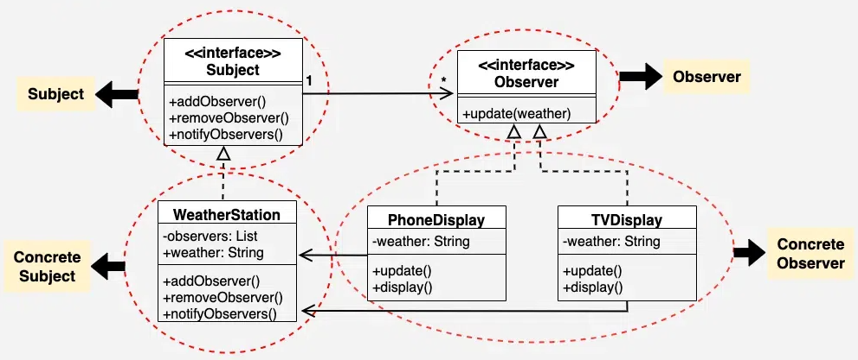
Design Patterns [10/10]
The following figure shows the observer pattern diagram:

Slide 35
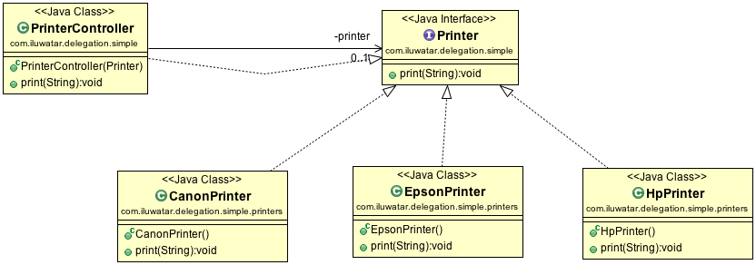
Delegation Pattern
Delegation is a relationship between objects.
Here, one object forwards method calls to another object, which is called its delegate.
Unlike inheritance, delegation does not create a super class.
Delegation does not force to accept all the methods of the super class.
Delegation supports code reusability and provides run-time flexibility.

Slide 36
Composition and Aggregation [1/6]
Composition refers to the process of composing a class from references to other objects.
Composition forms the building blocks for data structures.
Programmers can use object composition to create more complex objects.
In aggregation, one class owns another class.
In composition, when the owning object is destroyed, so are the objects within it but in aggregation, this is not true.
Composition and aggregation are design concepts and not actual patterns.

Slide 37
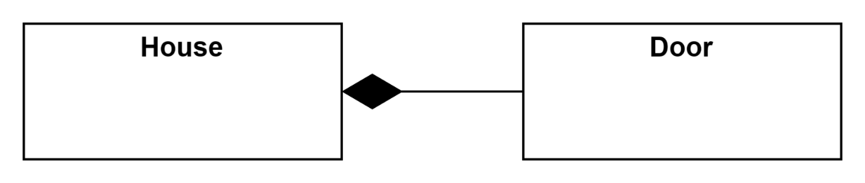
Composition and Aggregation [2/6]
Code Snippet
To implement object composition, perform the following steps:
Create a class with reference to other classes.
Add the same signature methods that forward to the referenced object.
// Composition
class House
{
// House has door.
// Door is built when House is built,
// it is destroyed when House is destroyed.
private Door dr;
};

Slide 38
Composition and Aggregation [3/6]
Consider an example of a student attending a course.
The student ‘has a’ course.
The composition for the Student and Course classes is depicted in the following Code Snippet:
Code Snippet
public class Course {
private String title;
private long score;
private int id;
public String getTitle() {
return title;
}

Slide 39
Composition and Aggregation [4/6]
public void setTitle(String title) {
this.title = title;
}
public long getScore() {
return score;
}
public void setScore(long score) {
this.score = score;
}
public int getId() {
return id;
}
public void setId(int id) {
this.id = id;
}
}

Slide 40
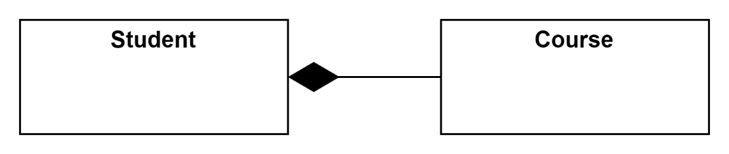
Composition and Aggregation [5/6]
public class Student {
//composition has-a relationship
private Course course;
public Student(){
this.course=new Course();
course.setScore(1000);
}
public long getScore() {
return course.getScore();
}
public static void main(String[] args) {
Student p = new Student();
System.out.println(p.getScore());
}
}

Slide 41
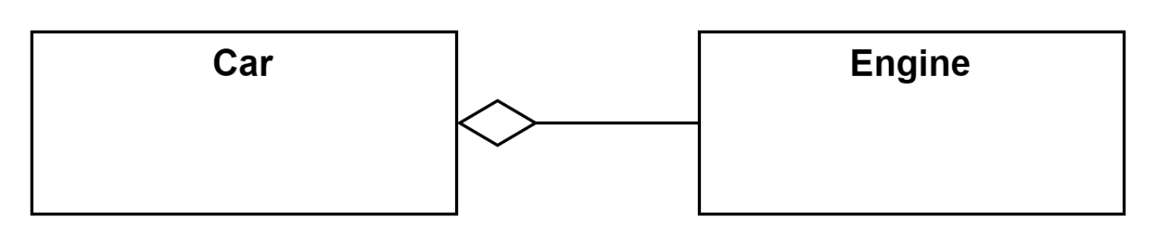
Composition and Aggregation [6/6]
class Car {
private Engine engine;
void setEngine(Engine engine) {
this.engine = engine;
}
void move() {
if (engine != null)
engine.work();
}
}

Slide 42
Summary
The development of application software is performed using a programming language that enforces a particular style of programming, also referred to as programming paradigm.
In structured programming paradigm, the application development is decomposed into a hierarchy of subprograms.
In object-oriented programming paradigm, applications are designed around data, rather than focusing only on the functionalities.
The main building blocks of an OOP language are classes and objects. An object represents a real-world entity and a class is a conceptual model.
Java is an OOP language as well a platform used for developing applications that can be executed on different platforms. Java platform is a software-only platform that runs on top of the other hardware-based platforms.
The editions of Java platform are Java SE, Java EE, and Java ME.
The components of Java SE platform are JDK and JRE. JRE provides JVM and Java libraries that are used to run a Java program. JDK includes the necessary development tools, runtime environment, and APIs for creating Java programs.

